Slide 1


Dictionaries
Day - 6

Slide 2
Dictionary
Dictionary in Python is an ordered collection of data values, used to store data values like a map, which, unlike other Data Types that hold only a single value as an element, Dictionary holds key : value pair. Key-value is provided in the dictionary to make it more optimized.
thisdict = { "brand": "Ford", "model": "Mustang", "year": 1964 }

Slide 3
Accessing Elements
thisdict = { "brand": "Ford", "model": "Mustang", "year": 1964 }
Accessing Elements
x = thisdict.keys() y = thisdict["model"]
Changing Items:
thisdict["year"] = 2018
Adding Items:
thisdict["color"] = "red"

Slide 4
Looping
thisdict = { "brand": "Ford", "model": "Mustang", "year": 1964 }
For items:
for x, y in thisdict.items(): print(x, y)
For keys:
for x in thisdict: print(x)
for x in thisdict.keys(): print(x)
For values:
for x in thisdict: print(thisdict[x])
for x in thisdict.values(): print(x)

Slide 5

Tasks
Try and check which all methods of other Data Structures are applicable to Dictionaries.
Write a program using dictionary which will return information about a student.
Write code which will take filename from user and give its filetype as output.

Slide 6

Tasks
Write a program to count the number of strings where the string length is 2 or more and the first and last character are same from a given list of strings.
Sample List : ['abc', 'xyz', 'aba', '1221’]
Expected Result : 2

Slide 7
Practice Resources
w3School: https://www.w3resource.com/python-exercises/dictionary/
Hackkerank: https://www.hackerrank.com/
Geeks for Geeks: https://www.geeksforgeeks.org/python-programming-language/?ref=shm

Slide 8
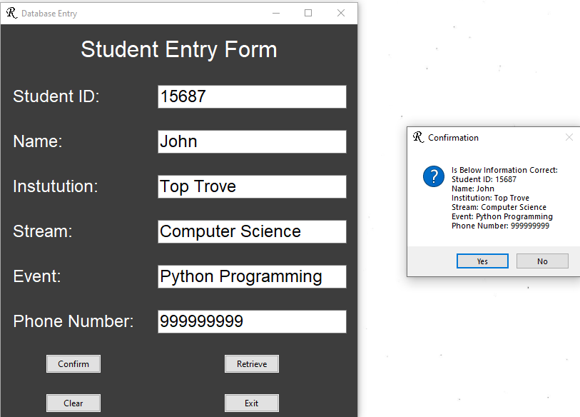
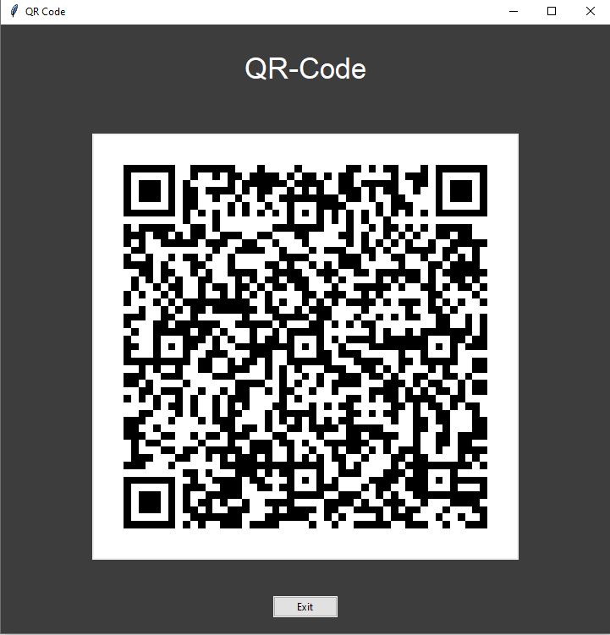
Projects Discussion

Slide 9
Thank You

